Slide 1


SECURE SOFTWARE DEVELOPMENT (SSD)
Diploma in CSF
Academic Year (AY) 22/23 – Semester 3 (April `22)
Week 12
Web application Vulnerabilities II
Last Updated: 26/06/2022

Slide 2
Contents
Mission 12.2: Cross Site Request Forgery Attack.
Ethical Considerations
Computer Misuse (Chapter 50A) and Cybersecurity Act
Mission 12.1: Cross Site Scripting (XSS)
Common Vulnerabilities
SQL Injection

Slide 3
Ethical considerations
As a student in ICT, you may have acquired certain knowledge and skills related to breaking, hacking or penetrating into programs, networks or systems as well as having access to security related tools.
You must use these knowledge and skills in an ethical and professional manner.
The School will not be responsible for your action(s) in the event you use these knowledge and skills inappropriately. You must take full responsibility for your own actions.

Slide 4
Computer Misuse (Chapter 50A) and Cybersecurity Act of Singapore
From this section onwards you would be attempting some of the OWASP Top 10 vulnerabilities on a deliberately vulnerable website called Mutillidae inside your own computer. You are not allowed to use these skills on any real/production/live websites or web applications.

Slide 5
Computer Misuse (Chapter 50A) and Cybersecurity Act
The Computer Misuse (Chapter 50A) Part 2 identified 8 offences:
Unauthorized access to computer materials
Access with intent to commit or facilitate commission of offense
Unauthorized modification of computer materials
Unauthorized use or interception of computer service
Unauthorized disclosure of access code
Unauthorized obstruction of use of computer
Enhanced punishment for offences involving protected computers
Abetments and attempts punishable as offences
A person convicted any of the above offences shall be liable to a fine not exceeding $100,000 or imprisonment for a term not exceeding 20 years or both.
Details: https://sso.agc.gov.sg/Act/CMA1993, https://sso.agc.gov.sg/Acts-Supp/9-2018/

Slide 6
Common Vulnerabilities
It is of utmost importance to understand and appreciate common software vulnerabilities that result in the compromise of computer assets, no matter what the programming languages used in the software.
Having good understanding of the software vulnerability enables one to better apply productive countermeasures.
There is no better way to understand the software vulnerability in depth, other than to experience it first hand.

Slide 7

Common Vulnerabilities
Click on link below to read the following common vulnerabilities:-
Cross Site Scripting I
Cross Site Scripting II
Cross Site Request Forgery

Slide 8
Launch Mutillidae – Inside Virtual Image
Experience cross-site scripting and cross site request forgery in OWASP Mutillidae II.
OWASP is a free, open source, deliberately vulnerable web-application with dozens of vulnerabilities and hints to help users understand the vulnerabilities better.
Launch Mutillidae now to learn about cross-site scripting and cross site request forgery.
Further reading: https://sourceforge.net/projects/mutillidae/

Slide 9
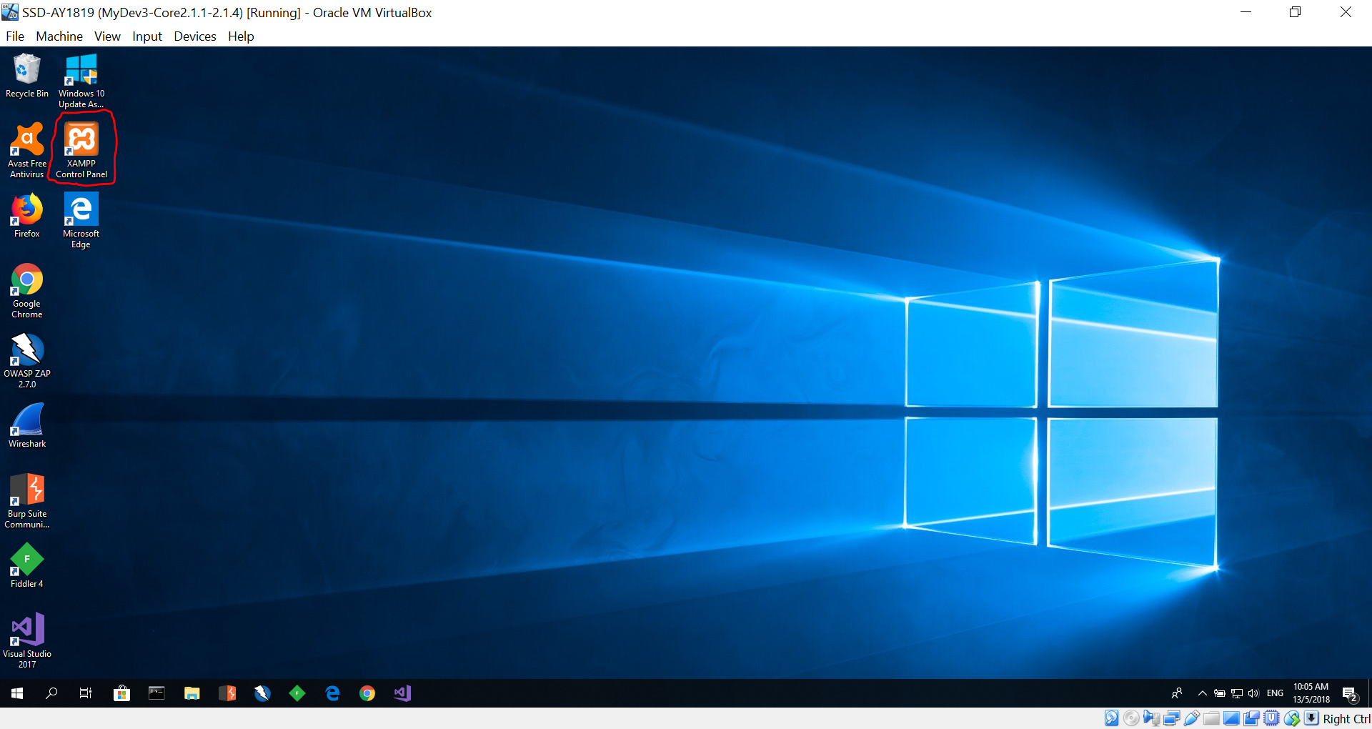
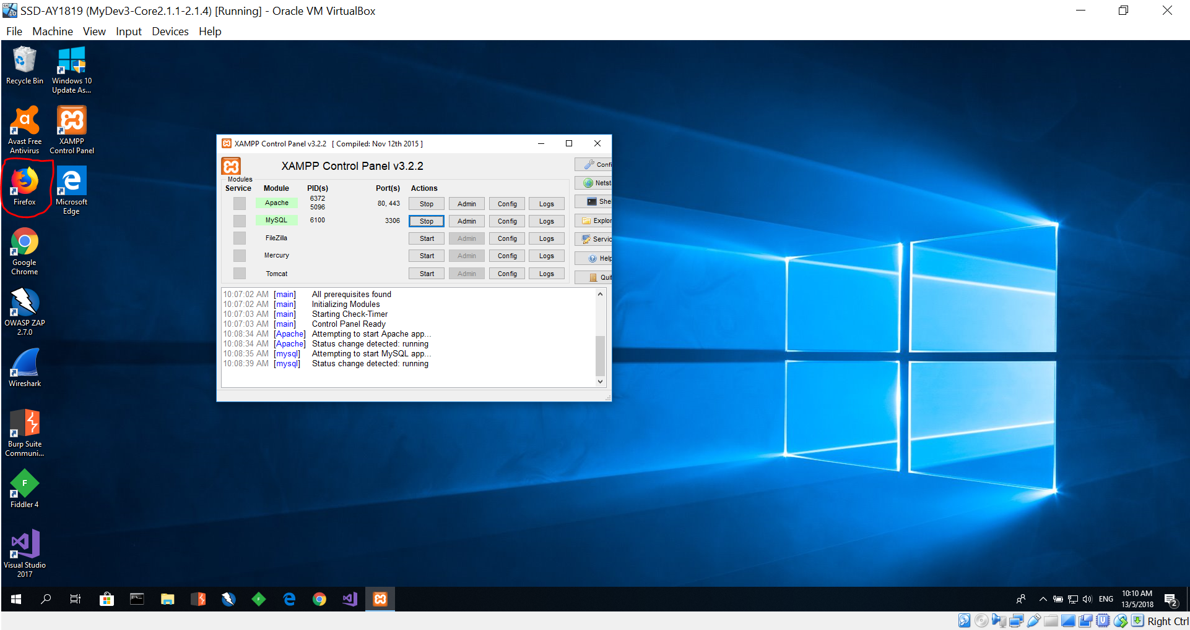
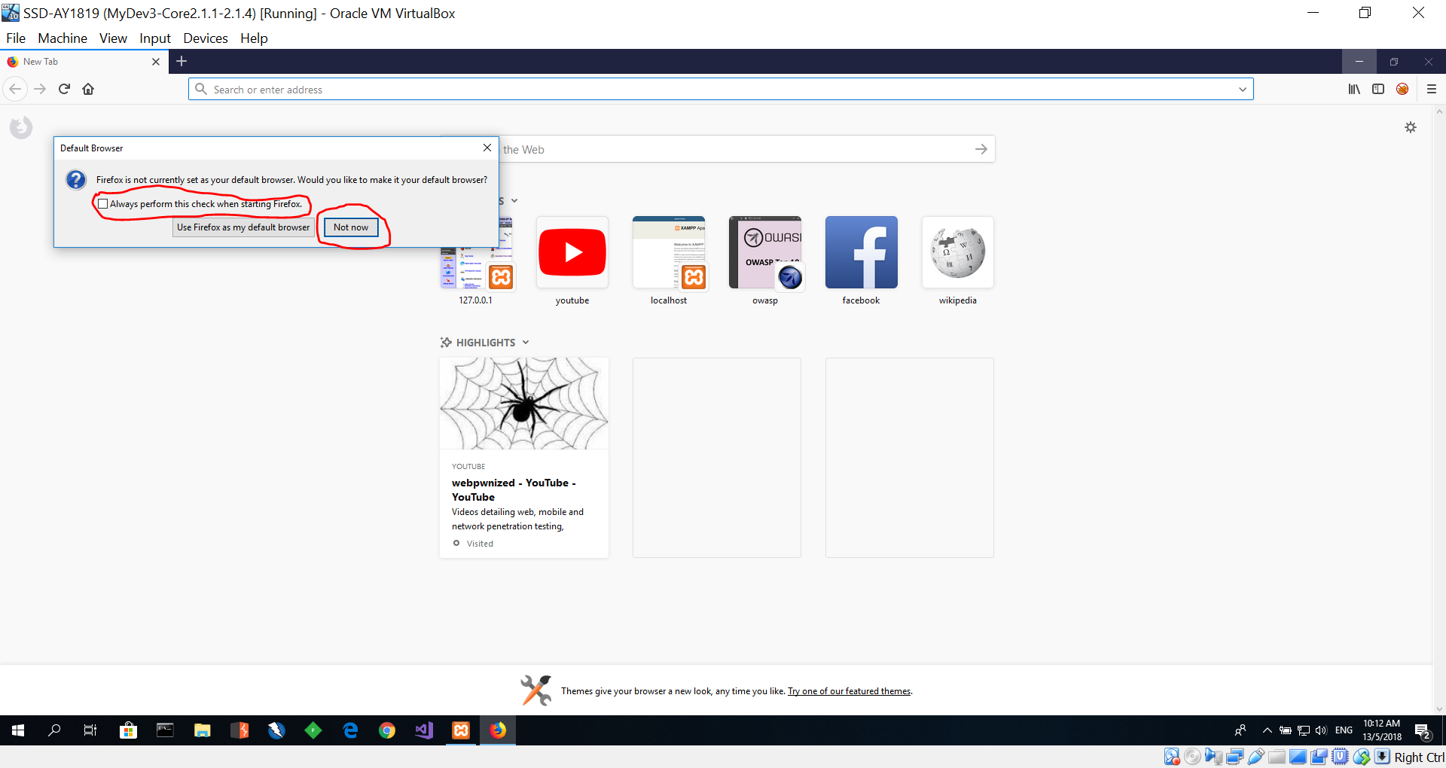
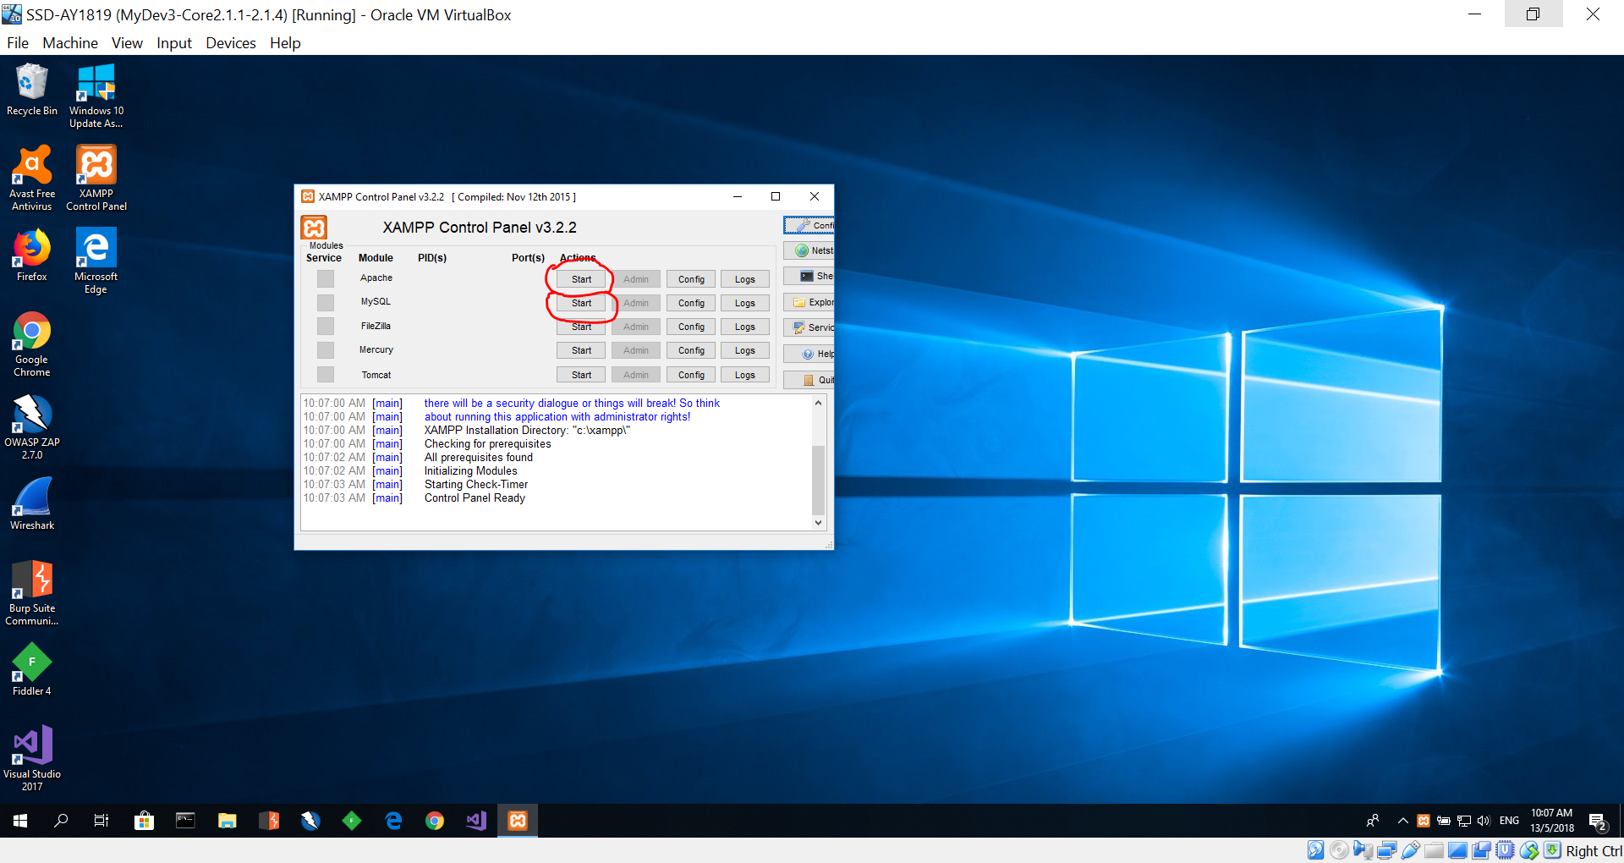
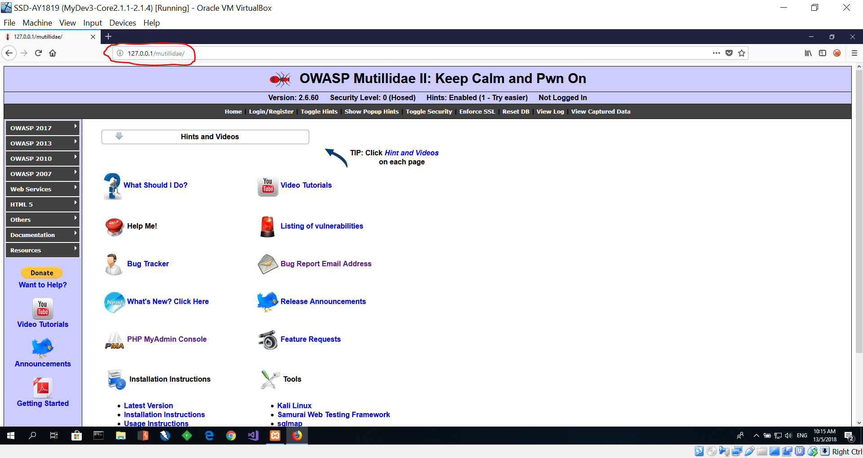
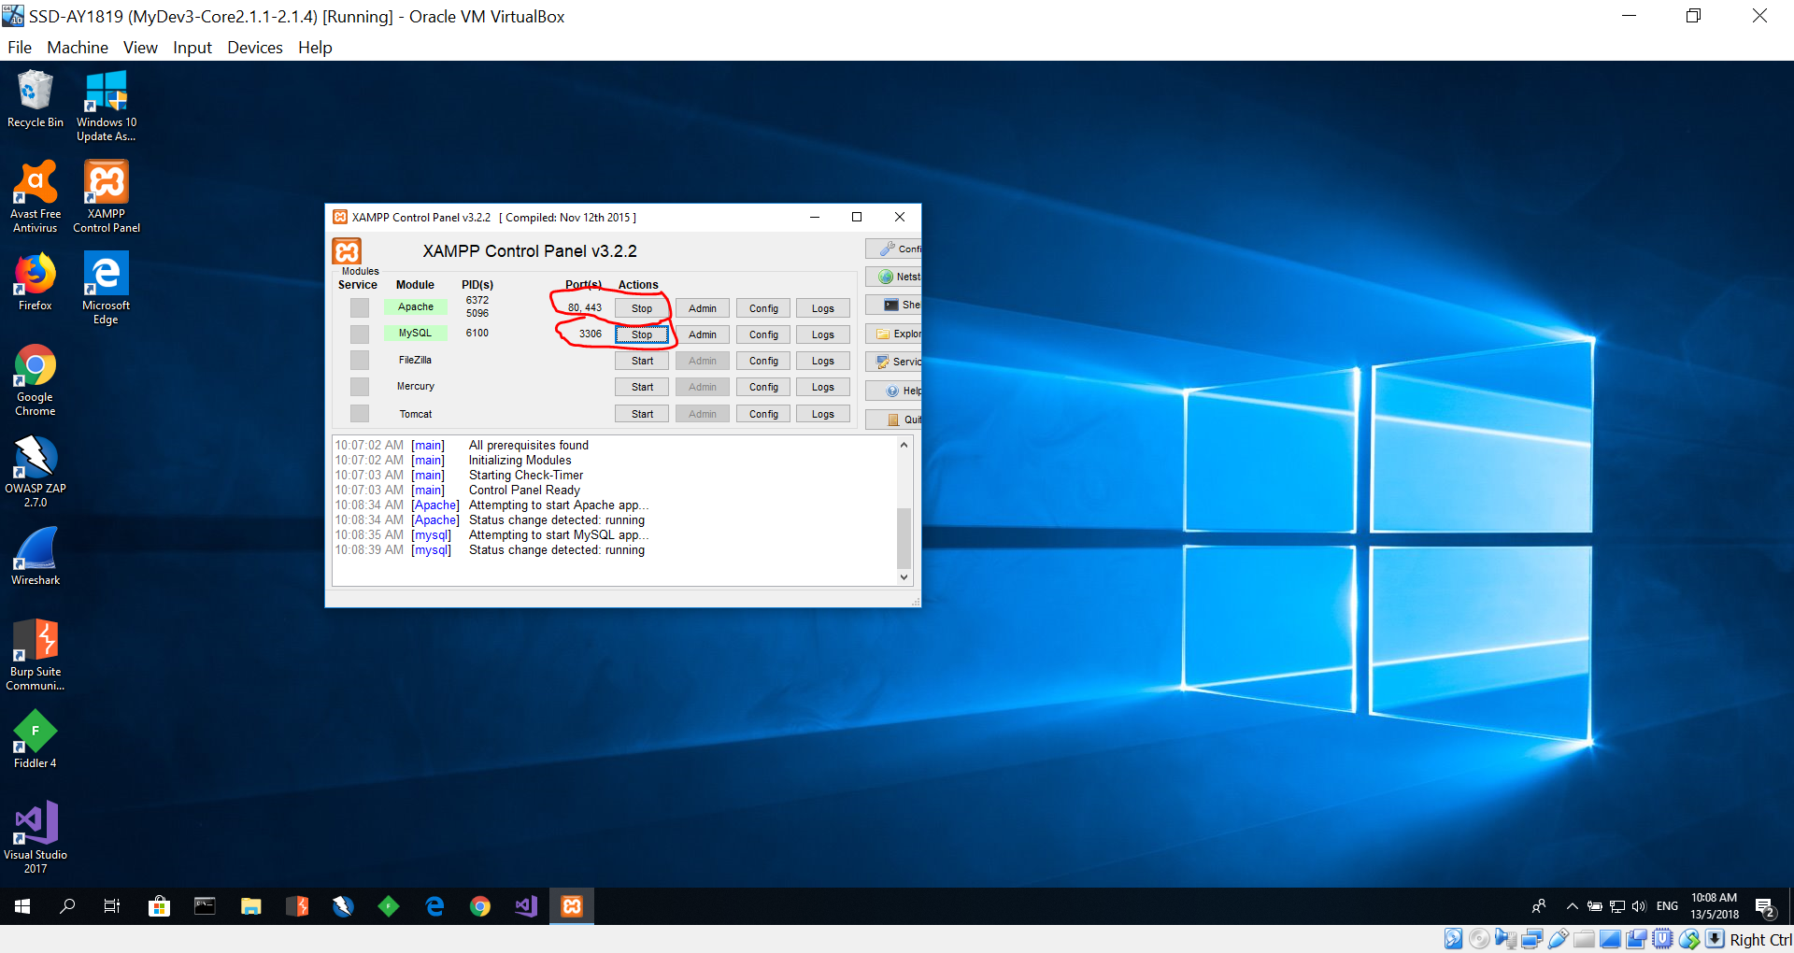
Launch Mutillidae – Inside Virtual Image
4
2
1
3
5

Slide 10
Setup (Optional) - Only for those who are not using the provided Virtual Image.
Download and install XAMPP server.
URL: https://www.apachefriends.org/download.html
Tutorial to install: https://www.youtube.com/watch?v=N43oVPkrTg8
Download the version: 7.2.4 / PHP 7.2.4 (https://sourceforge.net/projects/xampp/files/XAMPP%20Windows/7.2.4/)
After installing click on "start" buttons next to "Apache" and "MySQL".
If these two services cannot start due to port conflict, please follow this video and change the http port to 8880 and ssl port to 4443.
https://www.youtube.com/watch?v=AWtL1tSQVMk
Download “OWASP Mutillidae II” version 2.6.67 from Politemall
Unzip the downloaded file.
Copy and paste the "Mutillidae" folder in to xampp --> htdocs folder
Lauch your browser
Type: http://127.0.0.1/mutillidae
If you changed your ports type: http://127.0.0.1:8880/mutillidae
Click on "Reset DB".
Click "OK".
You should now be able to view Mutillidae website.

Slide 11

Cross Site Scripting (XSS)
A7 – Cross-Site Scripting (XSS)
https://youtu.be/IuzU4y-UjLw

Slide 12
Activity 12.1
Task:
View the following videos:-
https://www.youtube.com/watch?v=9kaihe5m3Lk - Video 1
https://www.youtube.com/watch?v=dxzU6djocJQ - Video 2
In your own words, write a report in word document of :-
What are the vulnerabilities shown in Video 1 & 2?
Explain how are the vulnerabilities in Video 1 & 2 different from one over the other?

Slide 13
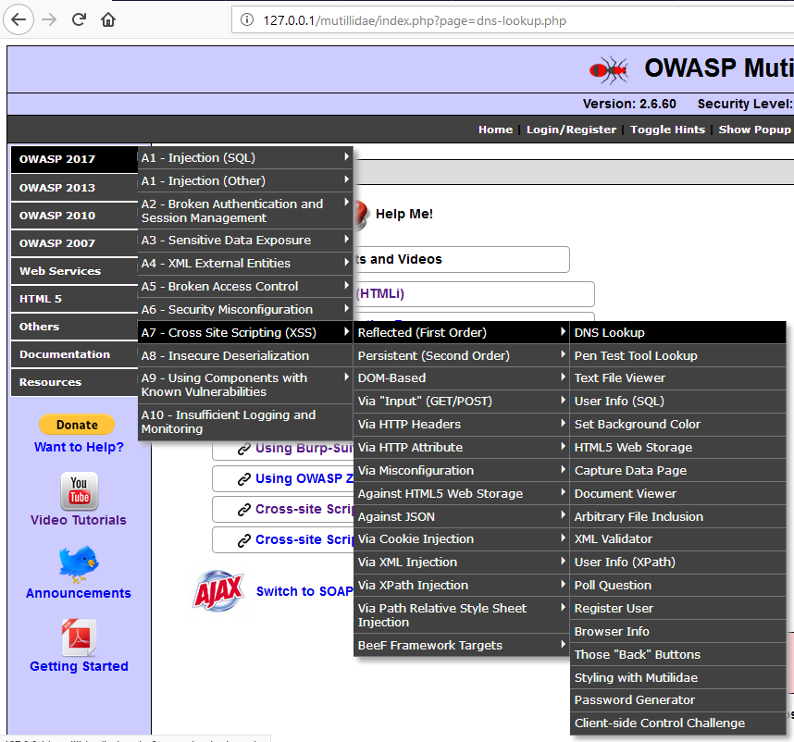
Cross Site Scripting in Mutillidae
You had watched the video. You can now do Cross Site Scripting (XSS) attack in Mutillidae.
Refer to Hint and Videos in Mutillidae for Cross Site Scripting assistance
OWASP 2017 → A7 – Cross Site Scripting (XSS) → Reflected (First order) → DNS Lookup
https://www.youtube.com/watch?v=PBG3ILCVous

Slide 14
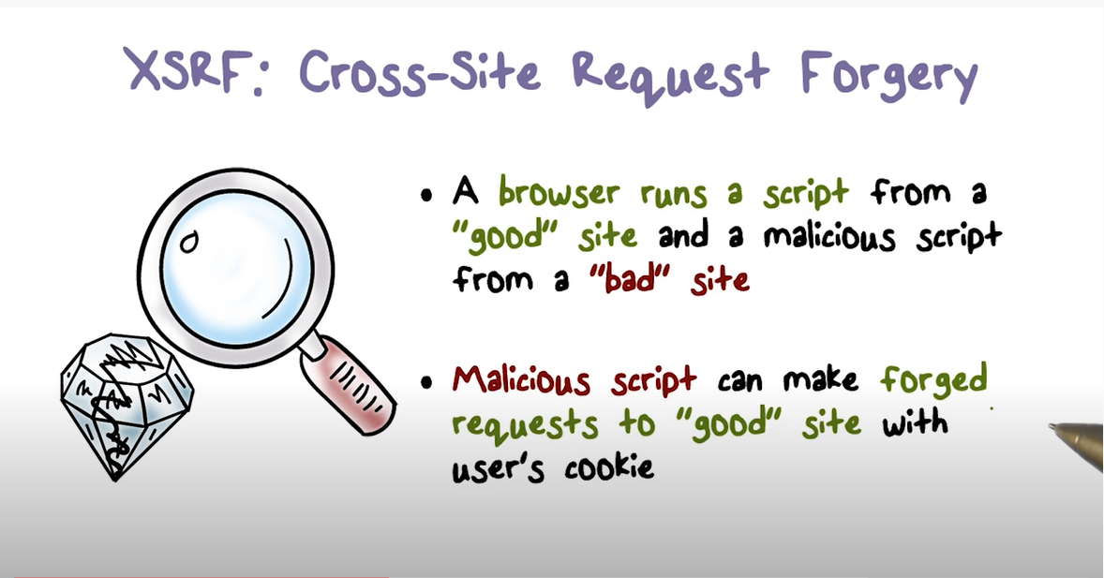
Cross Site Request Forgery Attack
Video
https://www.youtube.com/watch?v=9JrzPX1pVjs

Slide 15
Activity 12.2
Perform cross site request forgery (CSRF) in Mutillidae
OWASP 2013 --> A8 - Cross Site Request Forgery (CSRF) --> Add to your blog
Follow the Hints and Videos → Cross-Site Request Forgery (CSRF). (refer to slide 19)
Do the following tasks:-
Task 1: Create a user "sammy" with password "samurai“ (Slide 16)
Task 2: Force someone to add a blog without consent (Slide 17)
Task 3: CSRF on the User Poll (Slide 18)
Write a report of your experiences performing cross site request forgery attacks on the tasks given. Attached the screenshots captured into your report.
Upload your report into Teams group

Slide 16
Task 1: Create a user "sammy" with password "samurai“
Copy Script 1 from the text file provided in the CSRF-Scripts.txt – File in Politemall.
Paste Script 1 into "Add blog for anonymous"
Mouse over "Hello World" , user "sammy" with password "samurai", would be created.
Capture screenshot of your output

Slide 17
Task 2: Force someone to add a blog without consent.
Reset DB
Logout
Type "CANARY" into " Add blog for anonymous" and save blog entry
Right click "View Source", copy the source code into notepad
Save the notepad as "ForceBlogEntry.php" into XAMPP/htdocs/CSRF
Visit http://127.0.0.1/CSRF/ForceBlogEntry.php
Replace "CANARY" in ForceBlogEntry.php with Script 2
Refresh http://127.0.0.1/CSRF/ForceBlogEntry.php
Login to Mutillide as "jeremy" "password"
Visit http://127.0.0.1/CSRF/ForceBlogEntry.php and mouse over "Dancing with the stars results"
A blog entry "Add this guy to the Wall of Sheep" would be added to jeremy's blog.
Capture screenshot of your output

Slide 18
Task 3: CSRF on the User Poll
Reset DB
Logout
Type "CANARY" into "Add blog for anonymous" and save blog entry
Right click "View Source", copy the source code into notepad
Save the notepad as "ForcePollEntry.php" into XAMPP/htdocs/CSRF
Replace "CANARY" in ForcePollEntry.php with Script 3
Refresh http://127.0.0.1/CSRF/ForcePollEntry.php
Login to Mutillide as "jeremy" "password"
Visit http://127.0.0.1/CSRF/ForcePollEntry.php and mouse over "Vote for nmap. I know you will"
A forced poll entry would be made on his behalf of Jeremy.
(Refer to the scripts provide below)
CSRF-Scripts.txt – File in MEL.
Capture screenshot of your output

Slide 19
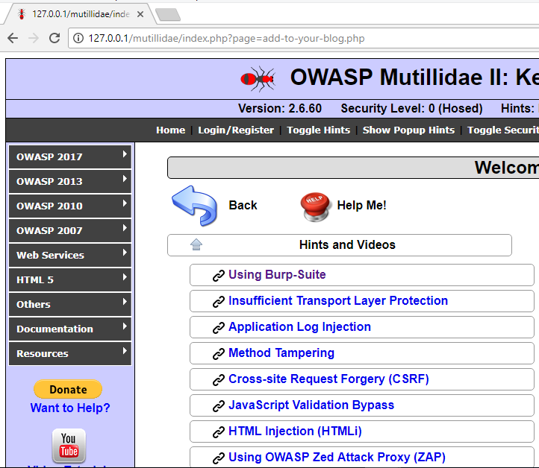
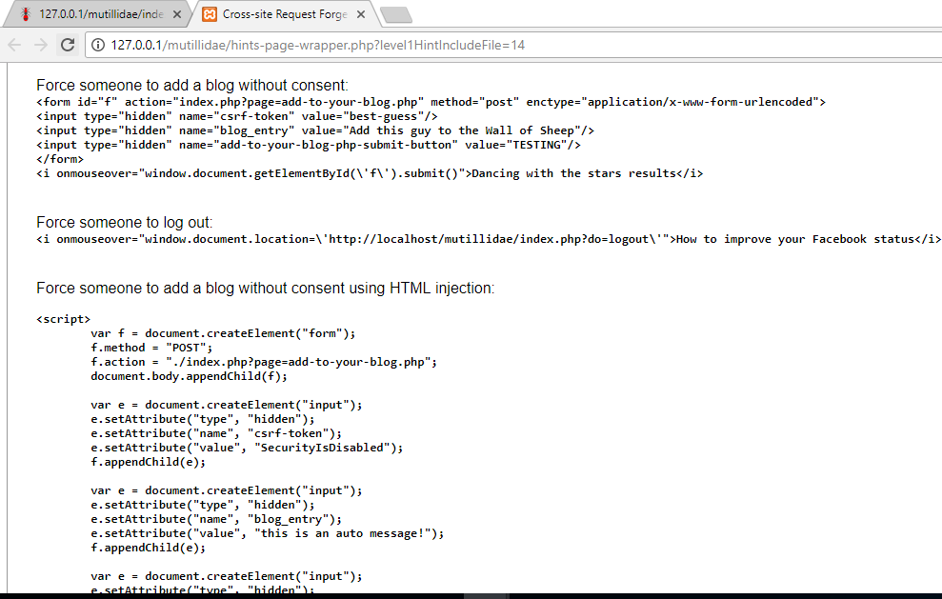
OWASP 2013 --> A8 - Cross Site Request Forgery (CSRF) --> Add to your blog

Slide 20
SQL Injection
SQL Injection
https://youtu.be/rWHvp7rUka8

Slide 21
Activity 12.3
Perform SQL Injection in Mutillidae
OWASP 2017 → A1 → SQLi – Extract Data → User Info (SQL)
Follow the Hints and Videos → SQL Injection (SQLi). (refer to slide 24)
Do the following tasks:-
Task 1: Determine if SQL injection exists (Slide 22)
Task 2: Determine number of columns in application query (Slide 22)
Task 3: SQL Injection - Others (Slide 23)
Write a report of your experiences performing SQL injection attacks on the tasks given. Attached the screenshots captured into your report.
Upload your report into Teams group

Slide 22
SQL Injection (Task 1 & Task 2)
Task 1: Determine if SQL injection exists
[Hint: https://www.youtube.com/watch?v=30h5DDesYhw]
Task 2: Determine number of columns in application query. Inject NULL columns until injected query works.
[Hint: https://www.youtube.com/watch?v=A0anLd7i268]
Note: Video of interest at 4min 20ec mark

Slide 23
Task 3: SQL Injection – Others
Task 3: [Hint: http://127.0.0.1/mutillidae/hints-page-wrapper.php?level1HintIncludeFile=10]
Attempt to determine database server brand
Attempt to determine database name
Attempt to determine schema name
Attempt to determine table(s) names
Attempt to determine column(s) names
Attempt to extract data
Attempt to read files from server
Attempt to determine database computer name, IP address, username, version, etc.
Extract passwords from user table
Dump user credentials

Slide 24
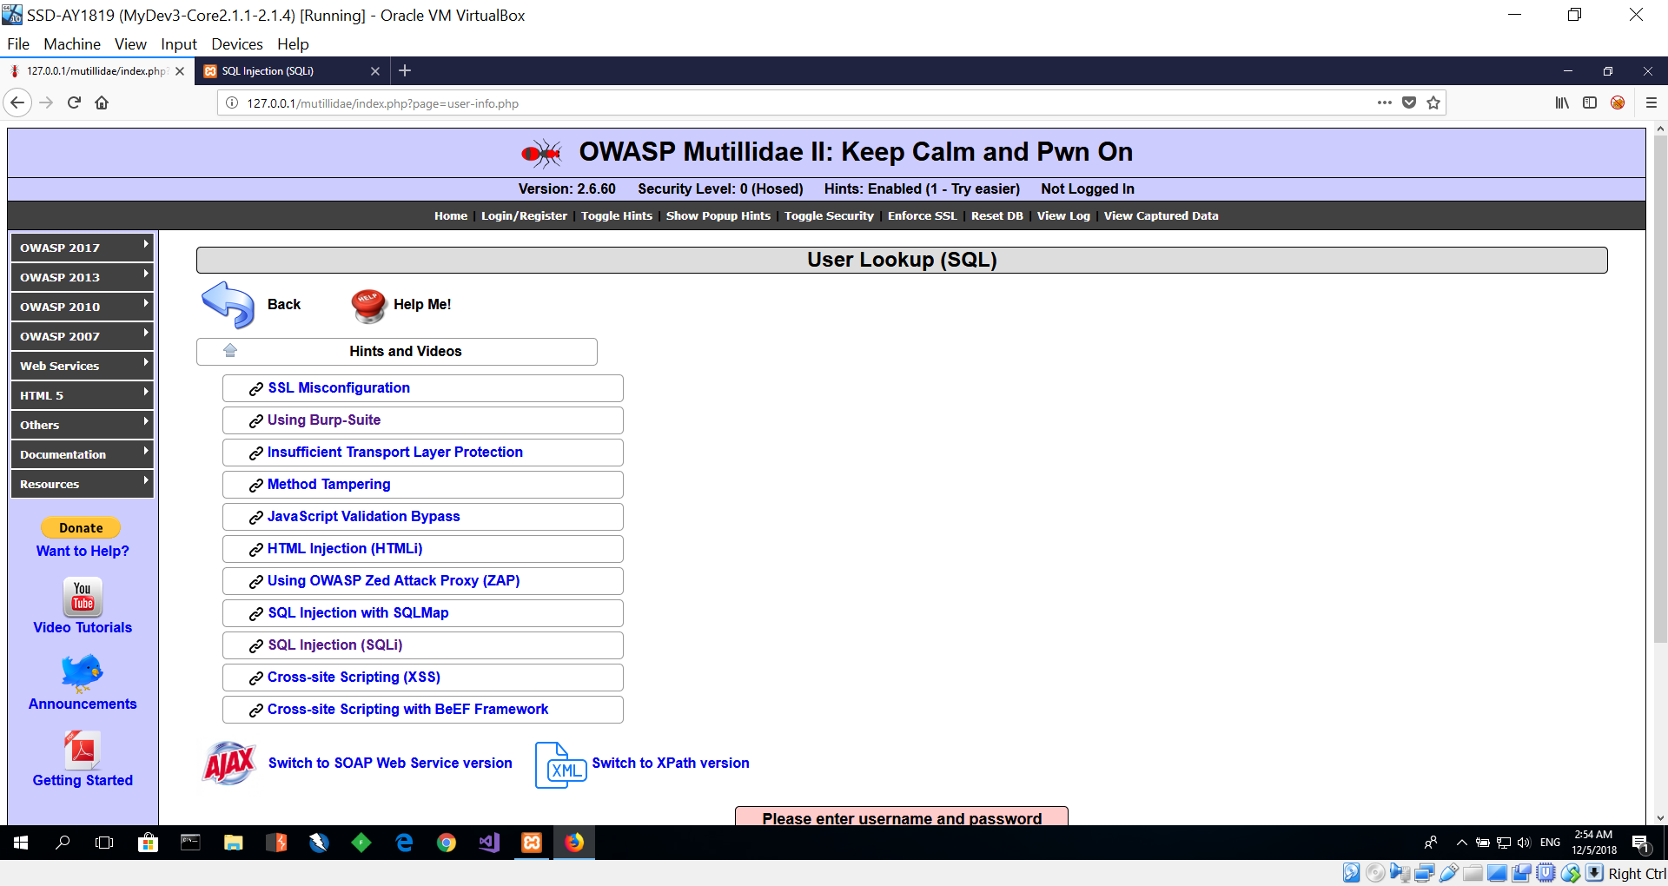
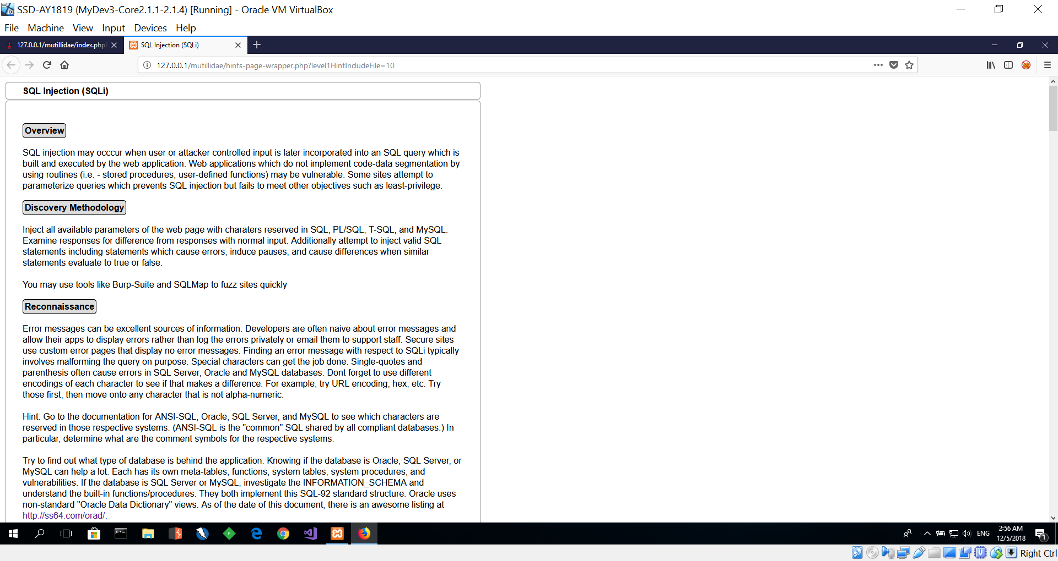
OWASP 2017 → A1 → SQLi – Extract Data → User Info (SQL)

Slide 25
Reflections - Individual
Reflect on Week 11, and Week 12 lessons
Inside your “SSD-AY2223-xxx-Pxx-Txx → Week 12”
Create another Wiki/OneNote tab “Your Name - Reflection”, and answer the following questions.
Identify 3 important learning points acquired from Week 11 & 12 lessons.
What do these learning points imply? Or what conclusions could you draw?
What will you do more of, less of, start or stop the next time? (In the context of the learning acquired thus far)
Deadline: Before the next week’s lesson

